Slide 1
Modelling of glucose-insulin homeostasis
(artificial pancreas)

Slide 2
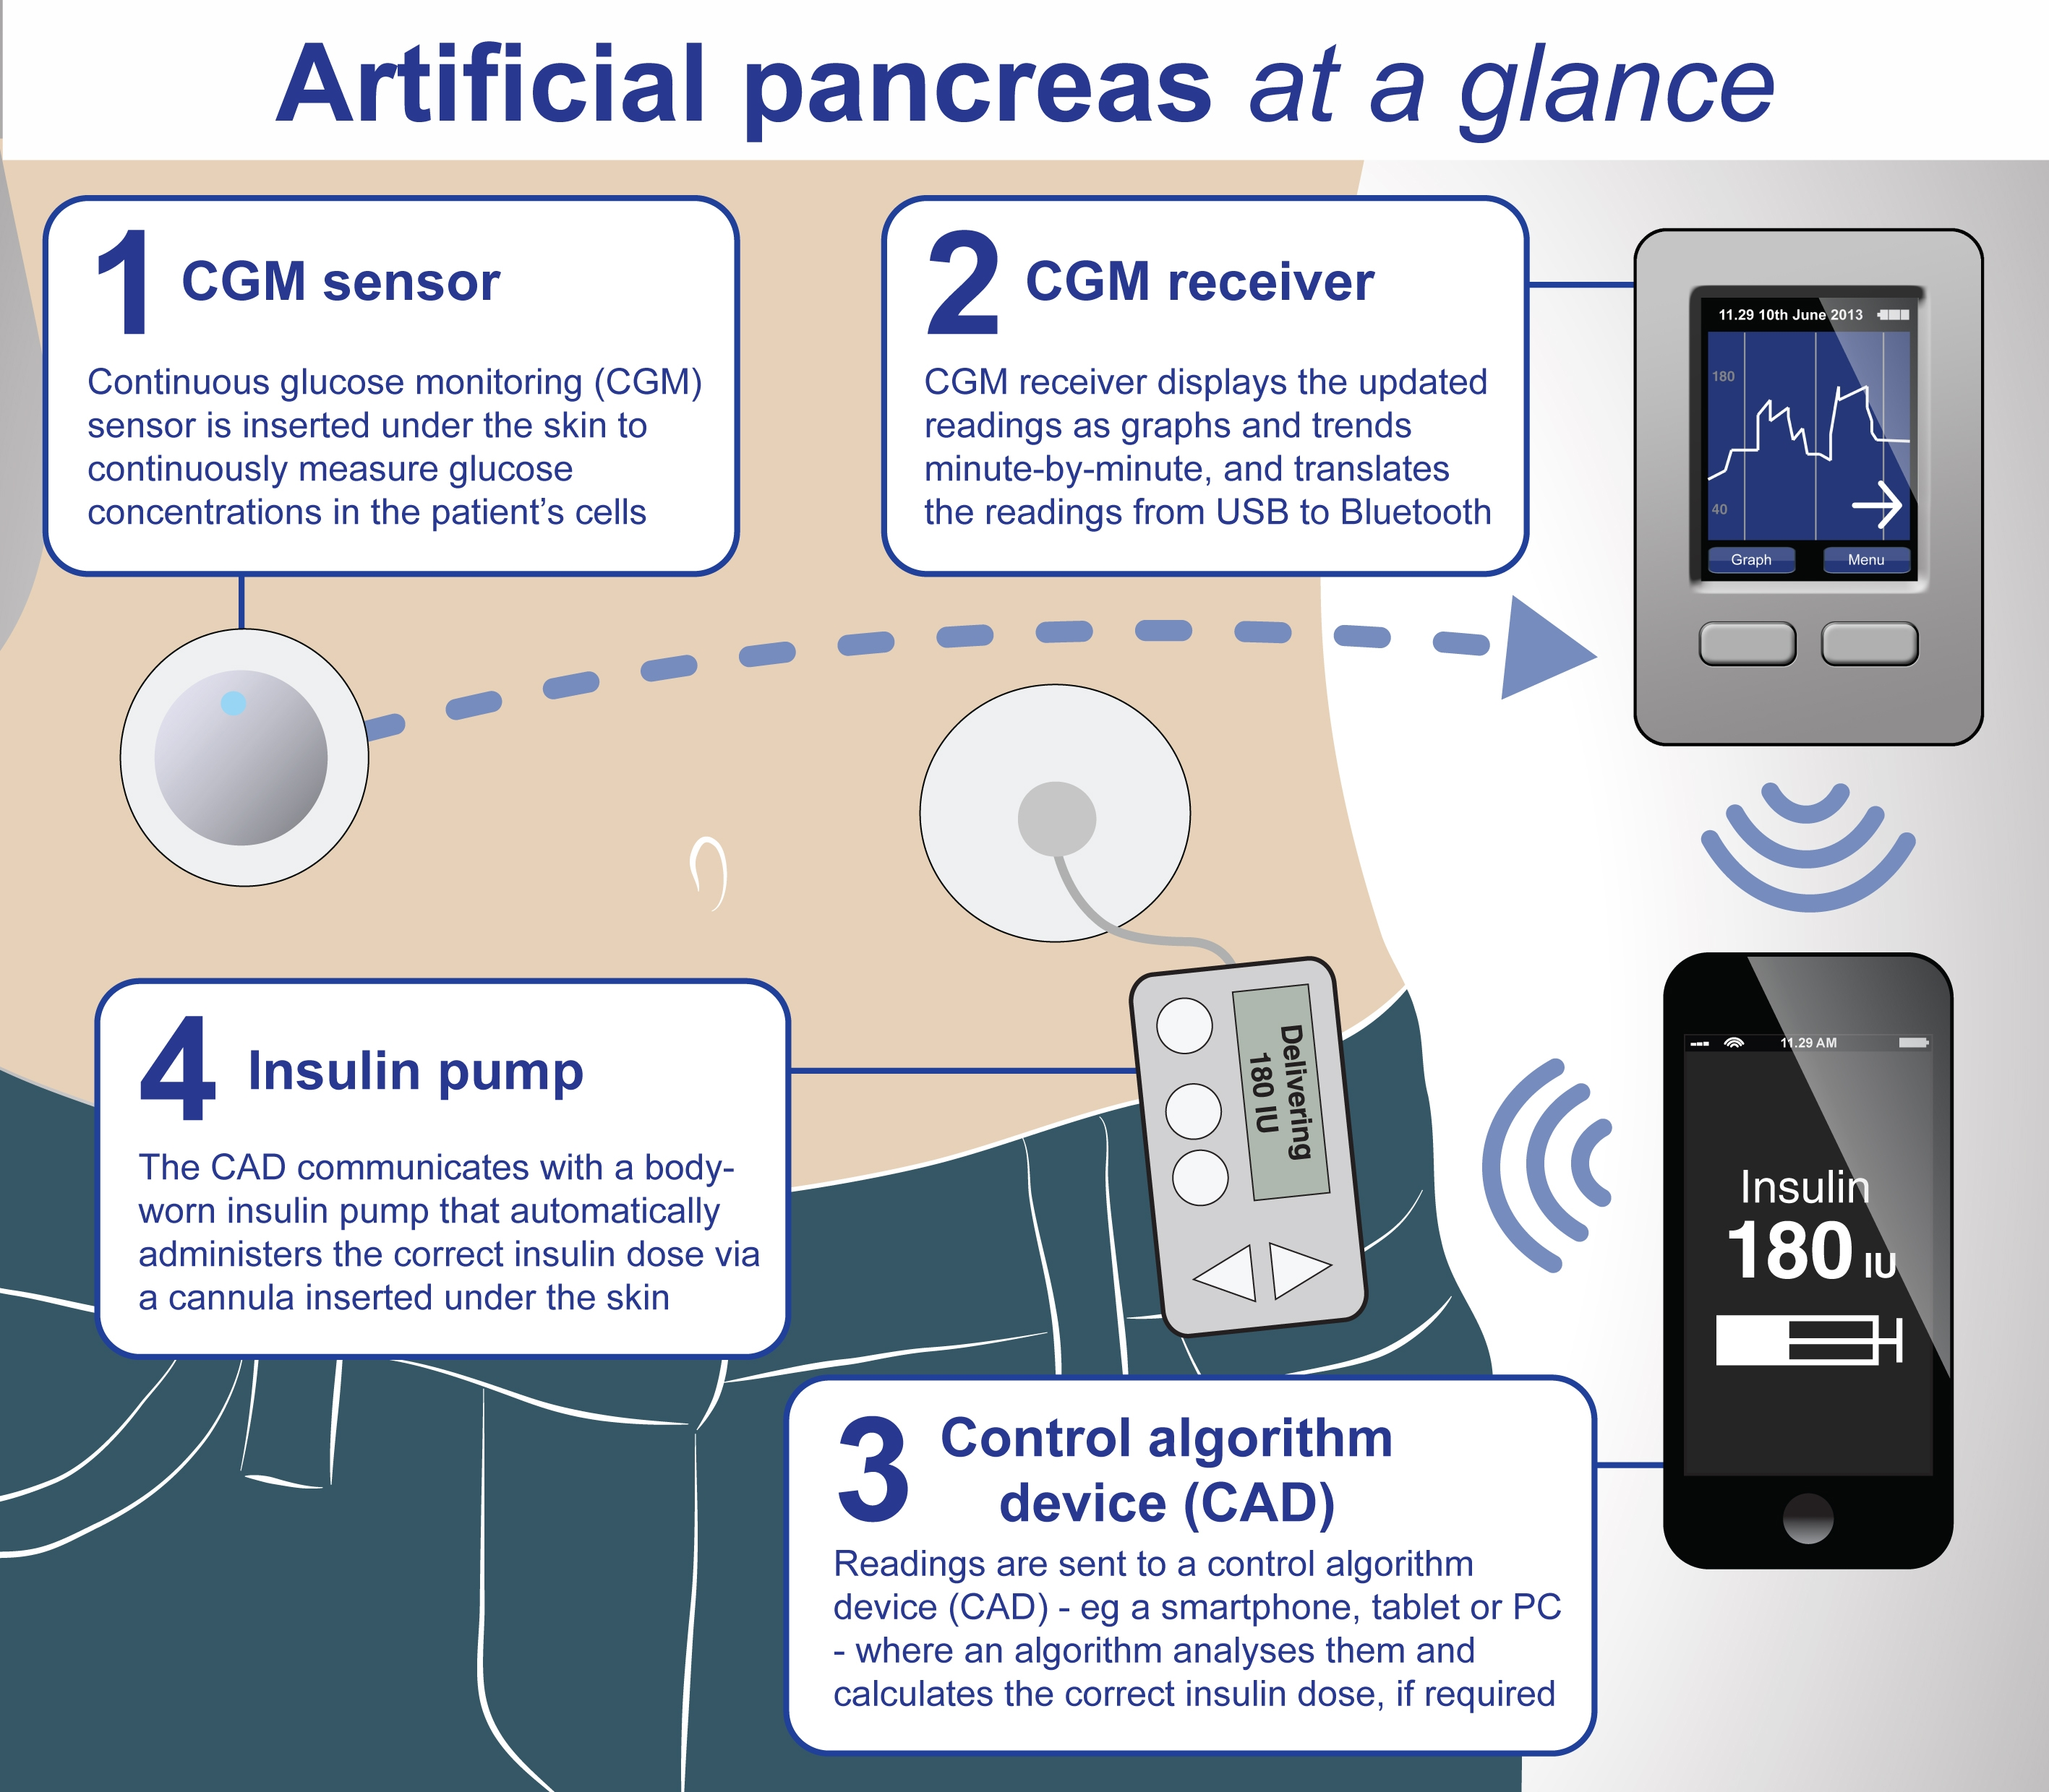
OBJECTIVE
To study various glucose-insulin homeostasis model and the advantages and disadvantages of these model over each other.
To study various mathematical modelling algorithm used for solving these model.
To come up with a model and an algorithm which can be successfully implemented on a embedded system which can then be used as an artificial pancreas(a control system with both controller and observer).
copied

Slide 3
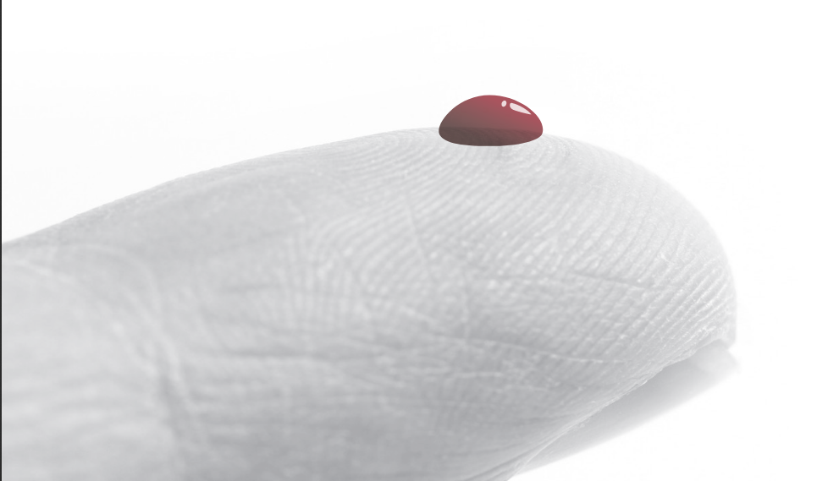
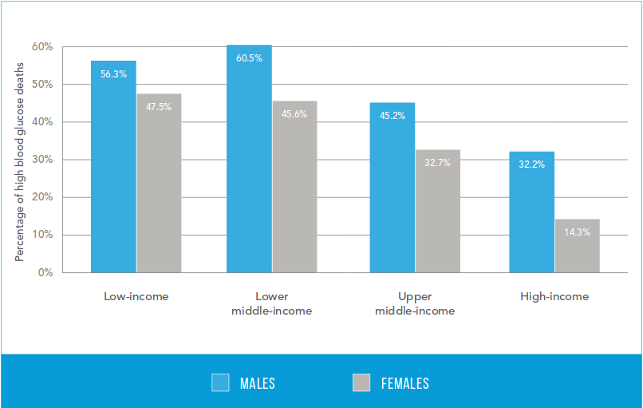
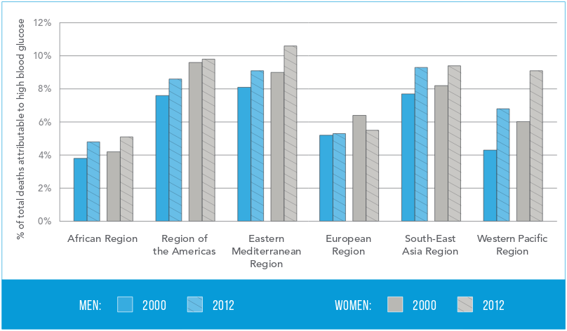
MOTIVATION
Globally, an estimated 422 million adults were living with diabetes in 2014, compared to 108 million in 1980.
Diabetes caused 1.5 million deaths in 2012.It was the eighth leading cause of death among both sexes and the fifth leading cause of death in women in 2012.
Diabetes is a chronic, progressive disease characterized by elevated levels of blood glucose known as hyperglycemia. Diabetes of all types can lead to complications in many parts of the body and can increase the overall risk of dying prematurely.
There are mainly two types of diabetes -
Type 1 DM results from the pancreas failure to produce enough insulin
Type 2 DM begins with insulin resistance, a condition in which cells fail to respond to insulin properly.
Insulin injection or doses are required to regulate the blood glucose level in our body, but the limitation of the current management is the death of a large no of patients by hypoglycaemic shock due to overdose of insulin as the dose is calculated manually. Around 2-4% of patients with T1DM die due to hypoglycemic shock. Also in case of T2DM using insulin doses turns out to be a better and cheaper way of dealing with the complications.
Researches are ongoing, to create an artificial pancreas which can automatically regulate the blood glucose level in the body by releasing appropriate amount of insulin in the body depending upon the glucose measurement alone.

Slide 4
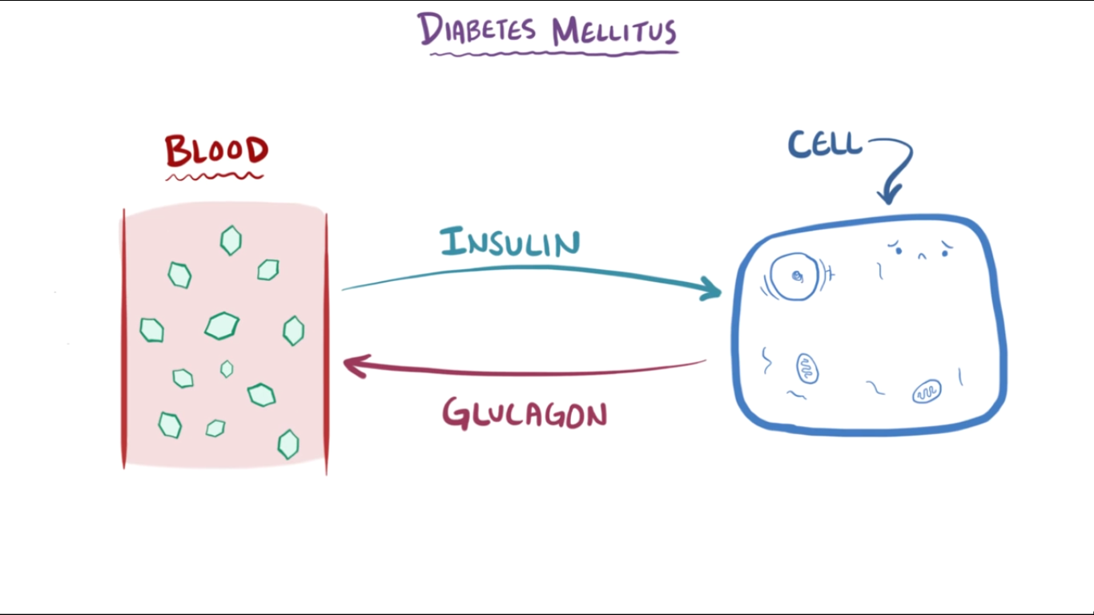
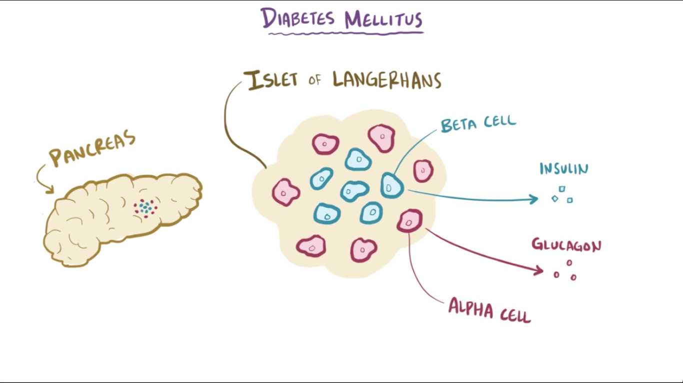
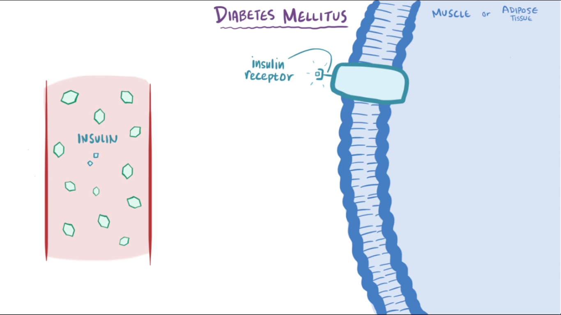
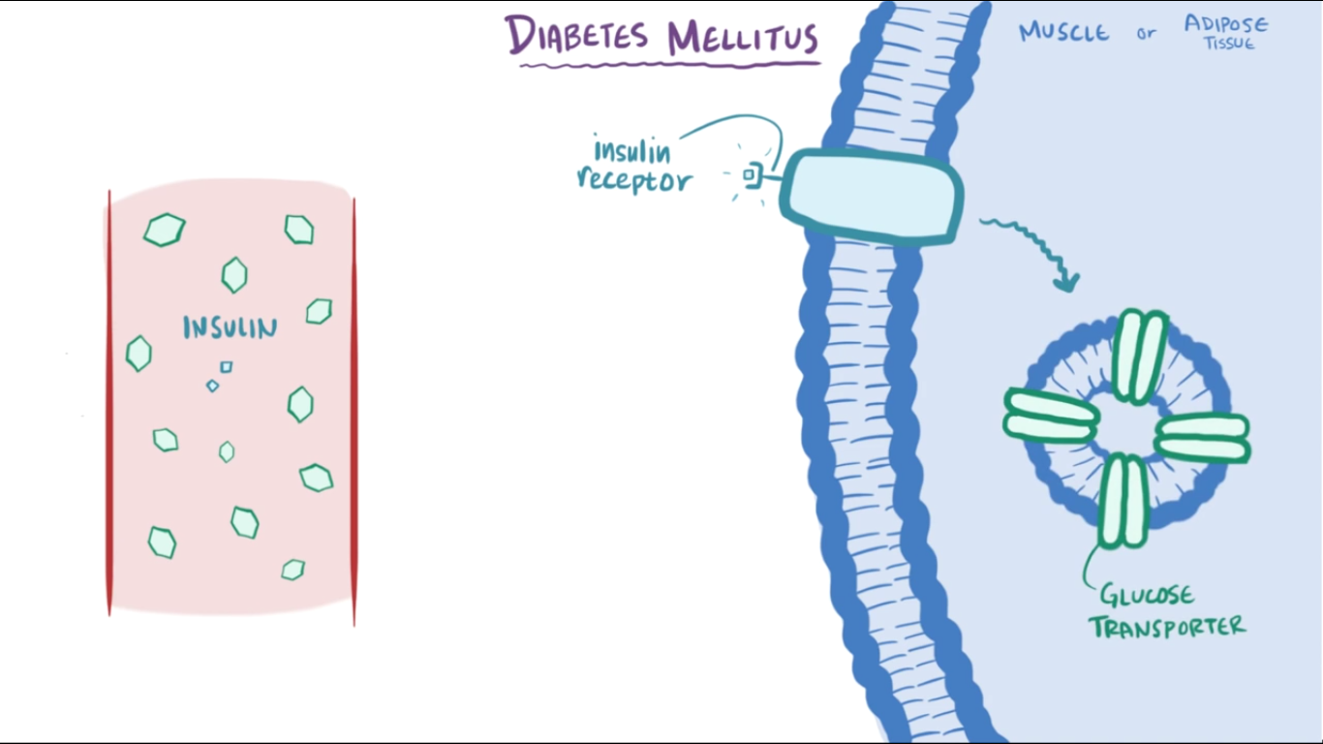
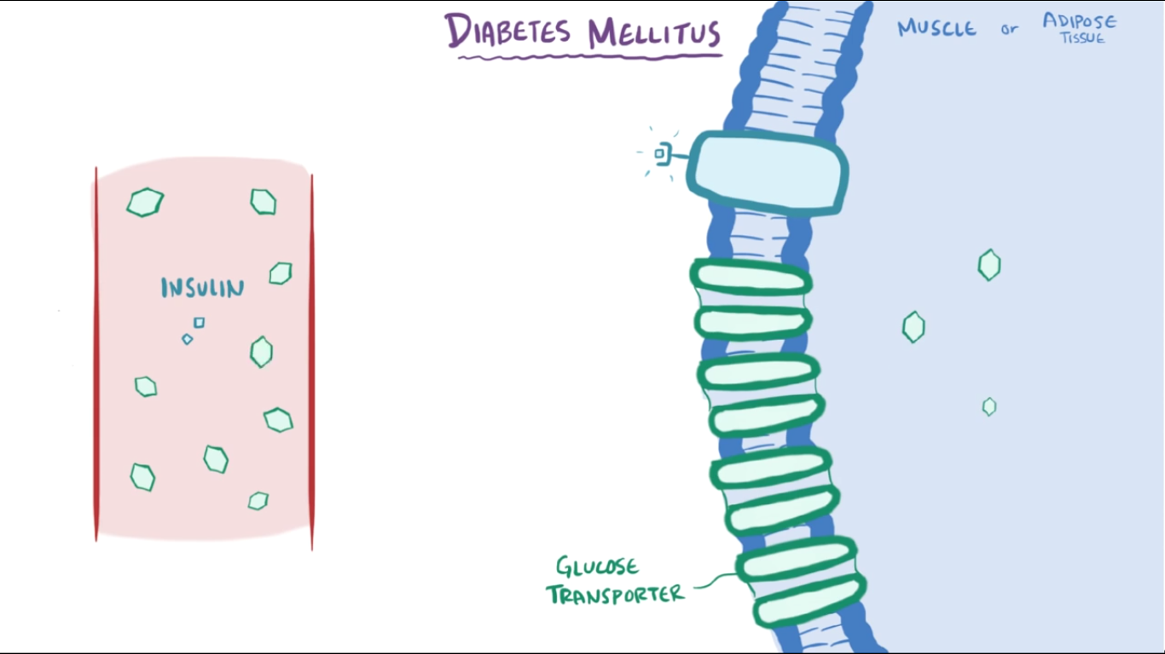
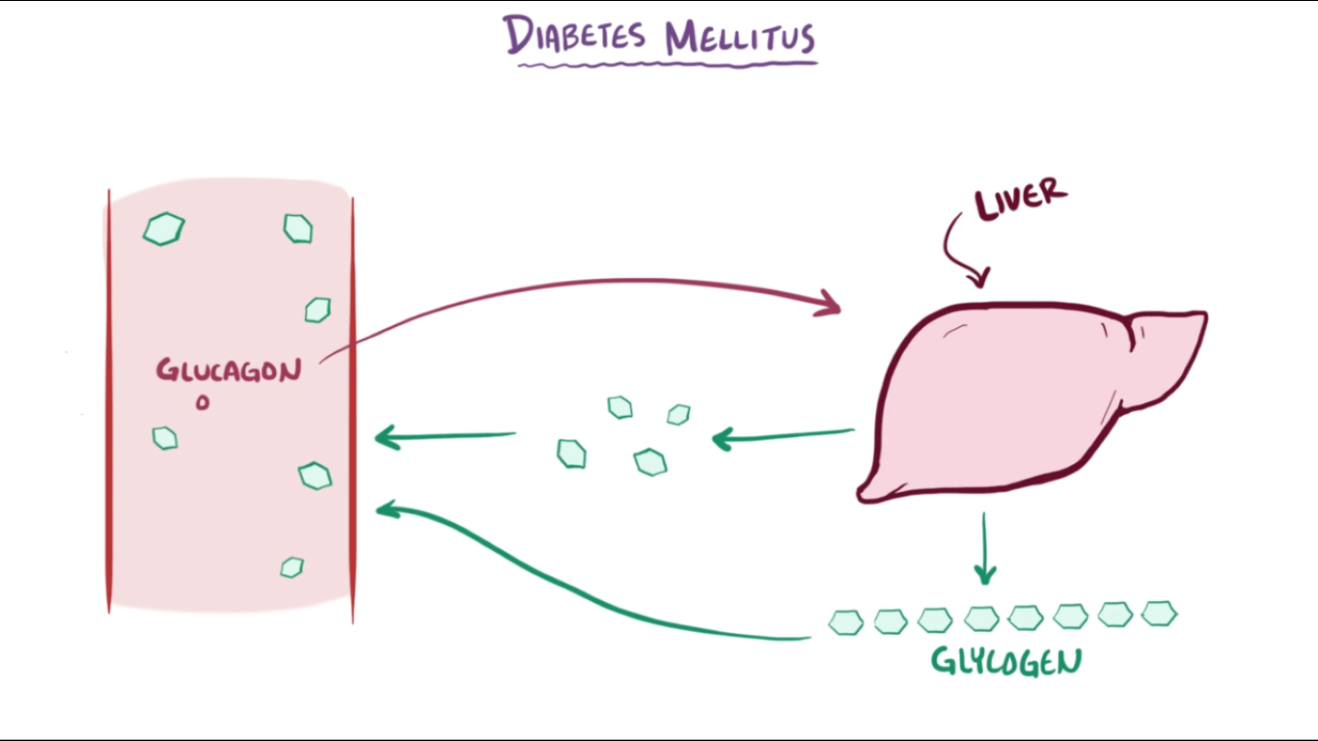
WHAT IS DIABETES

Slide 5
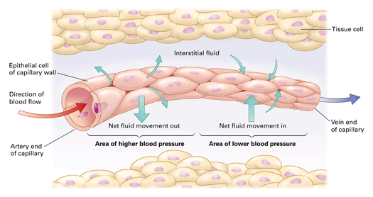
Structure Of Vein

Slide 6
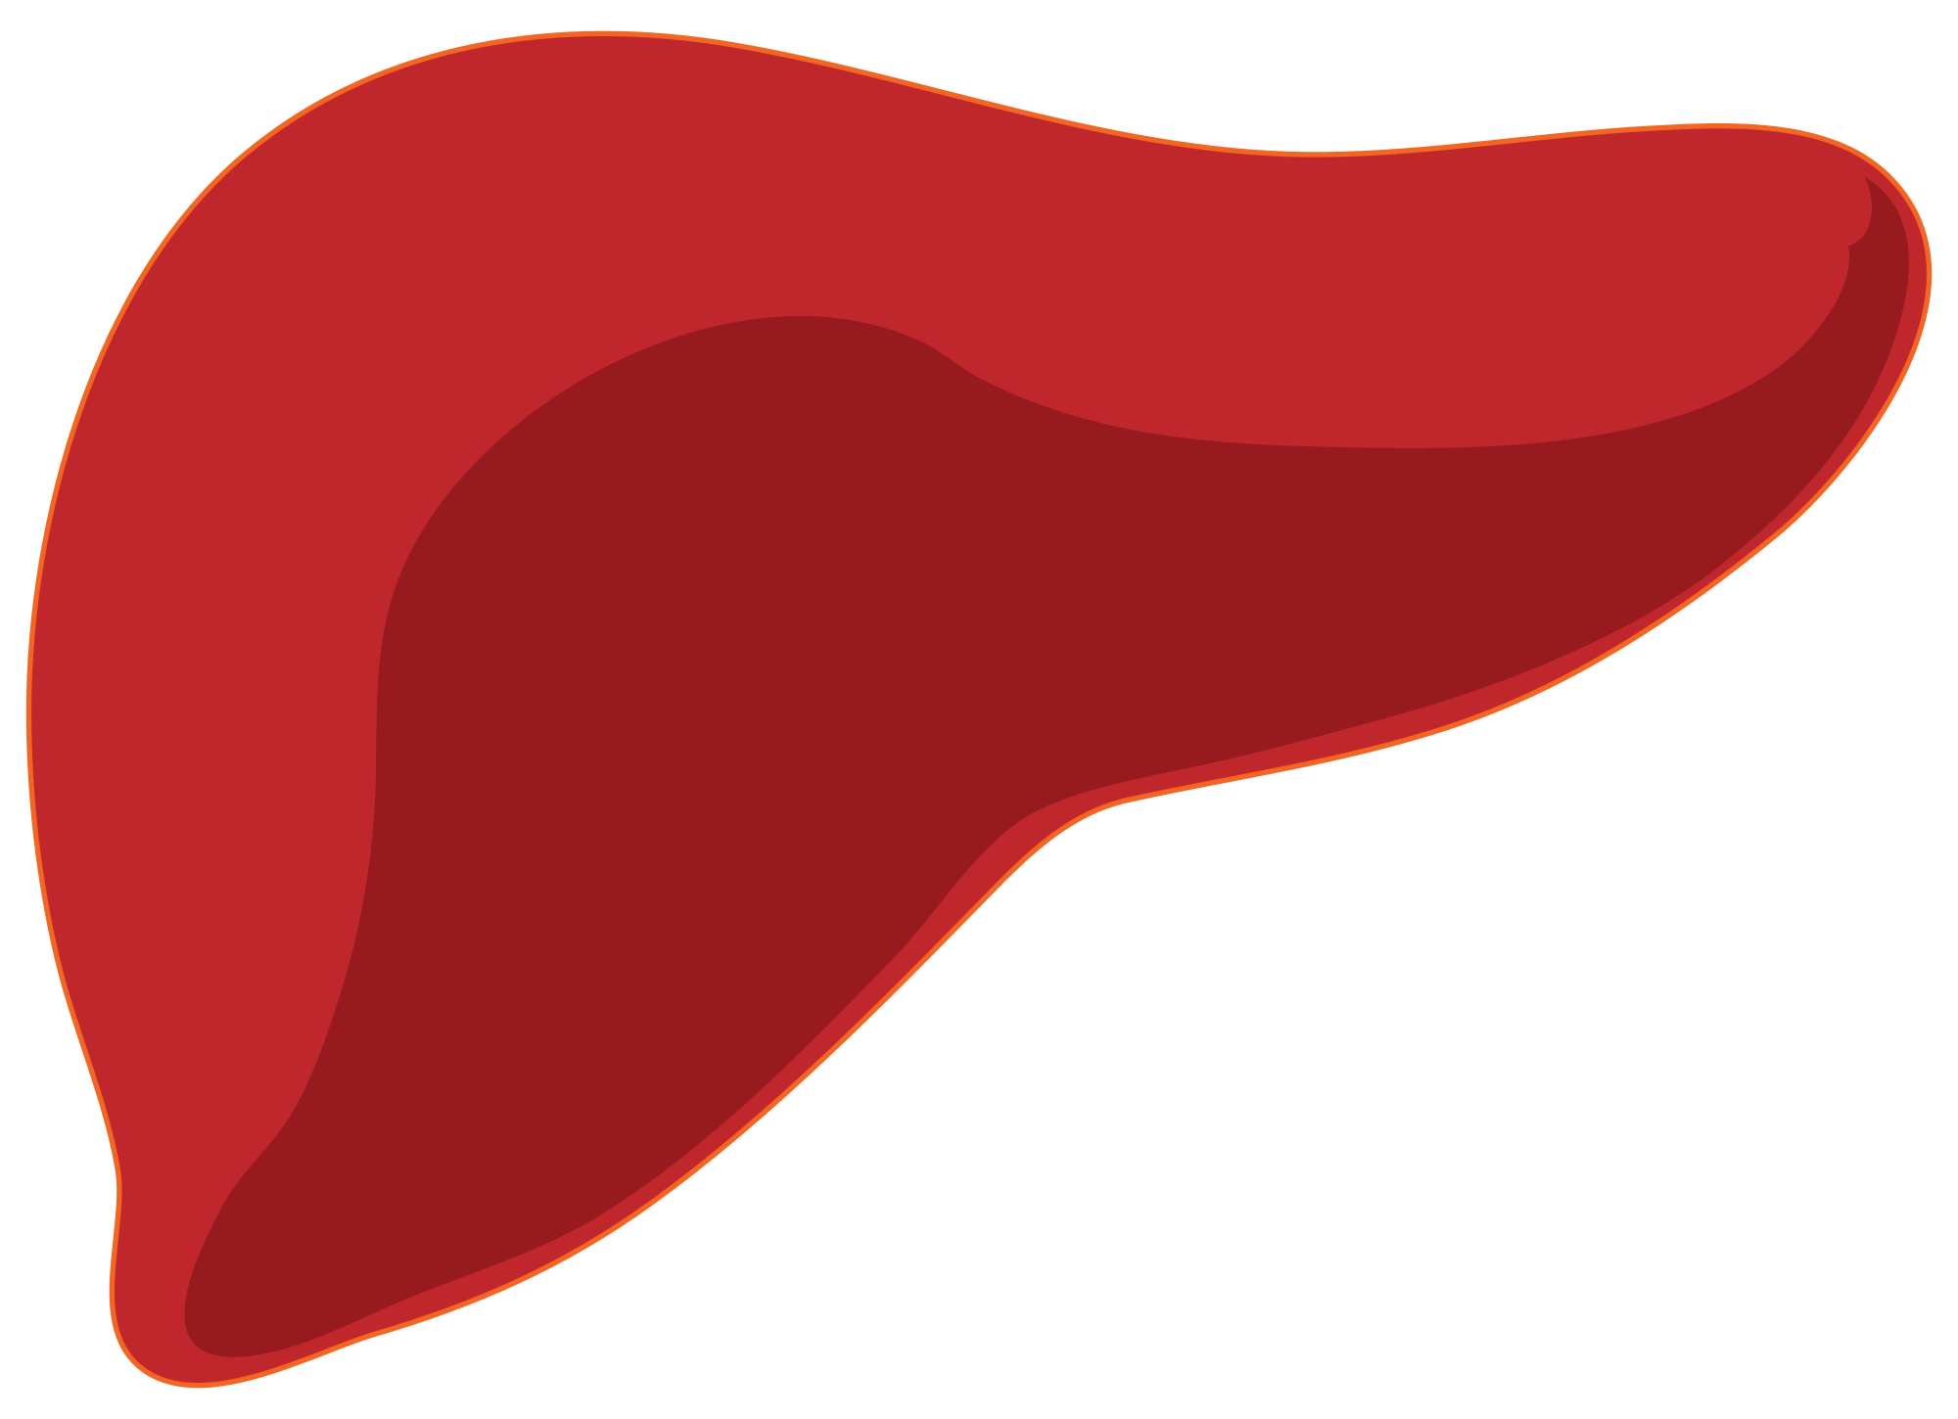
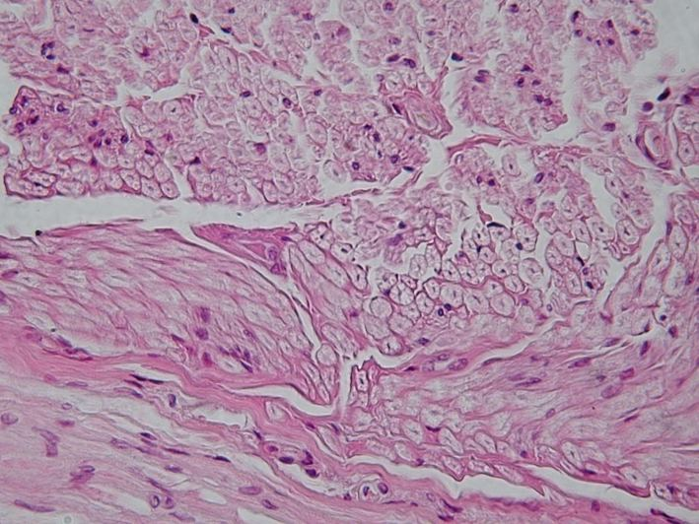

Model Of The Physiological Process (Bergman’s Minimal Model)
Dose of glucose
This is not modelled for IVGTT test.
B_{o} - R_{do} = k₅*G_{b} + k₁*G_{b}
NHGB
B_{o}
Glucose Compartment
G(t)
R_{do}+ k*G(t)
Increase of Glucose
Decrease of Glucose
liver
Decrease of Glucose
k₅*G(t)
Peripheral tissues
k₆*I₂(t)*G(t)
k₄*I₂(t)*G(t)
Effect of Insulin on glucose conc.
Remote pool of active insulin
I₂(t)
Effect of Insulin on glucose conc.
Plasma insulin
I(t)
k₂* [ I(t) - I_{b} ]
k₃* I₂(t)

Slide 7
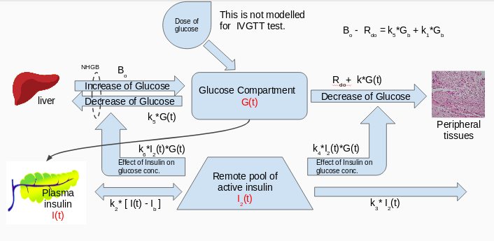
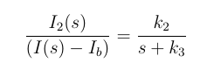
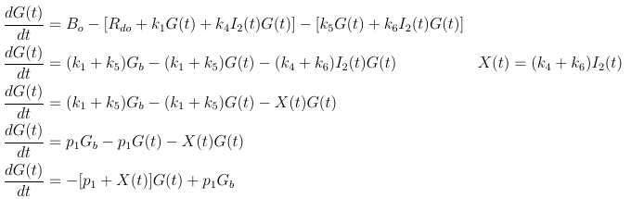
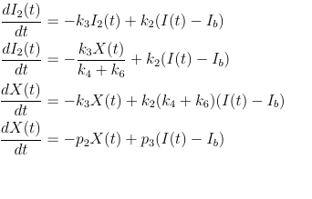
A First Order Delay Equation

Slide 8
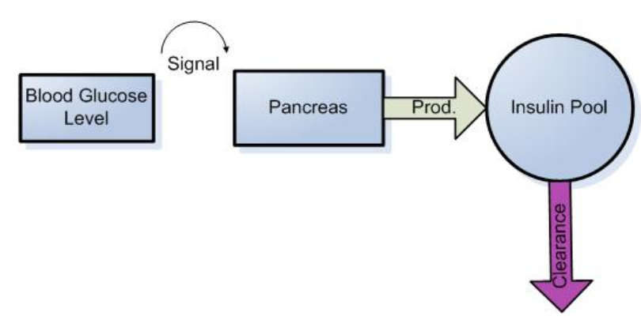
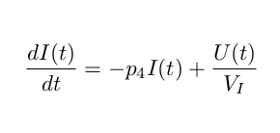
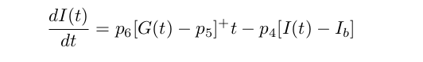
Insulin Minimal Model
The above model takes care only for the endogenous insulin produced by the pancreas.
To take care for the injected insulin, the equation used is given below.
copied

Slide 9
Distributed Data ODE Problem
Distributed data ODE problems are those in which we need to solve the system of ODEs (linear or non-linear) where we have data which over-determine the system and there might be errors in the data.
We will be using iterative algorithm for solving of such system of ODEs and for parameter estimation.
We will be using iterative least square regression algorithms for understanding of the model -
Gradient Descent
Newton Gauss
Lebvenberg Marquardt
Other algorithms like Genetic Algorithm (attains global Maxima), non parametric algorithm like Neural Network and real time non-linear version of Kalman filter are also used for understanding of the system.Implementation of these algorithm will also be done.
I have implemented Marquardt algorithm using in-built matlab algorithm nlinfit and ode15 has been used as a solver.

Slide 10
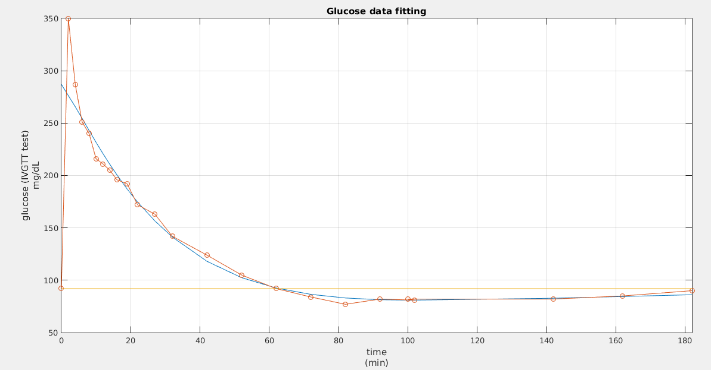
Glucose data fit using LMA algorithm

Slide 11
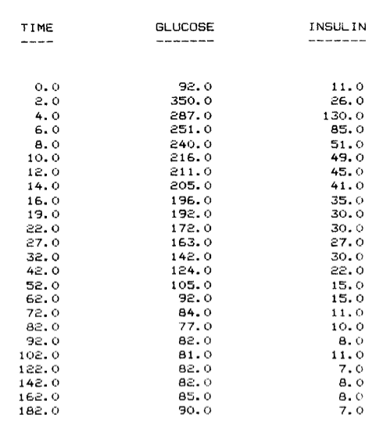
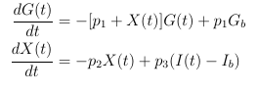
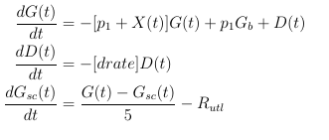
Modifying Glucose Minimal Model
The above model is known as Bergman minimal model.
The drawback of this model is that it is closely related to the IVGTT test and is used for deriving the Glucose effectiveness and Insulin sensitivity. Also it does not take care of external glucose dose taken through mouth or through subcutaneous route.
To address such issues, the above model is modified a little bit to take care
of the above problems.

Slide 12
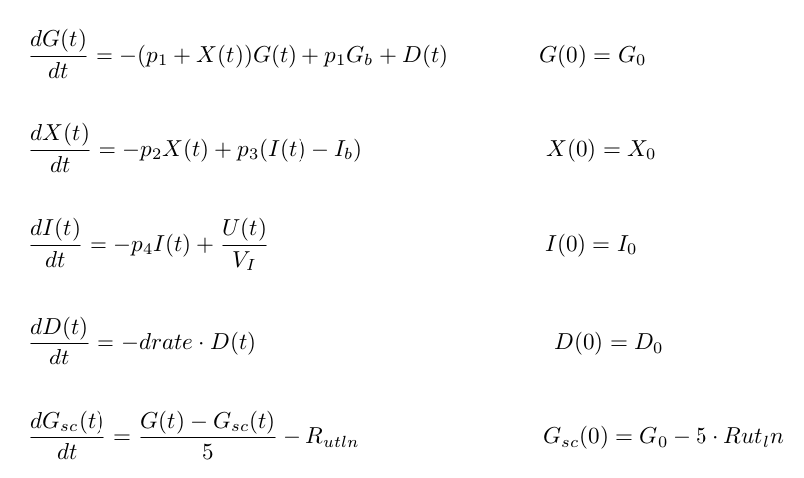
The Modified Model

Slide 13
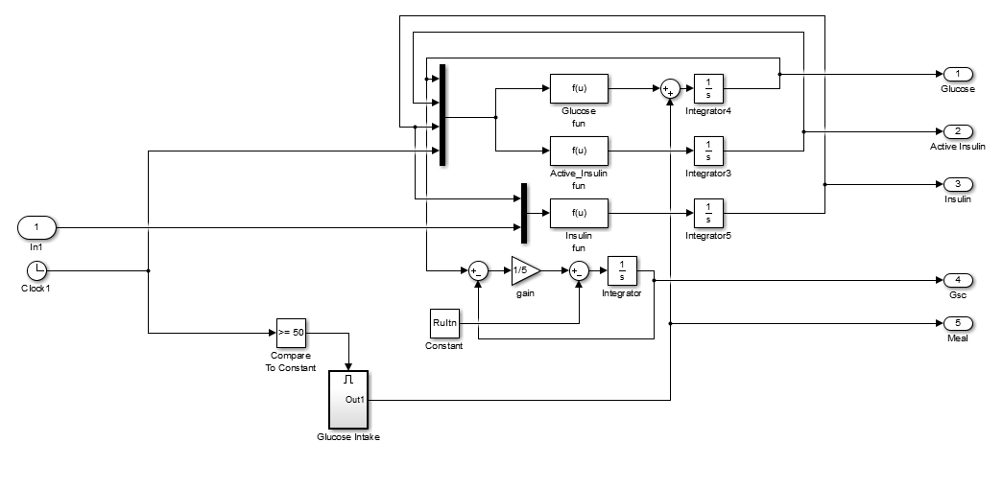
MODIFIED BERGMAN MODEL

Slide 14
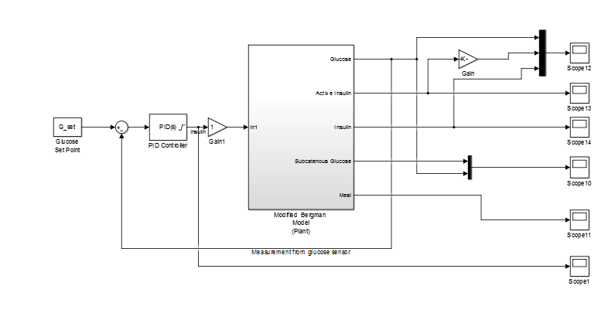
PID CONTROLLER

Slide 15
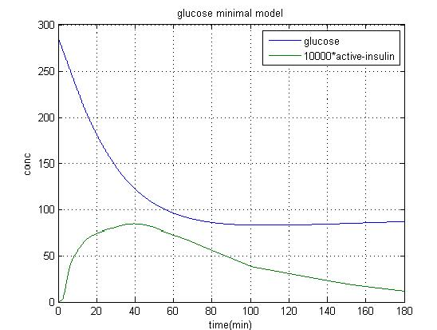
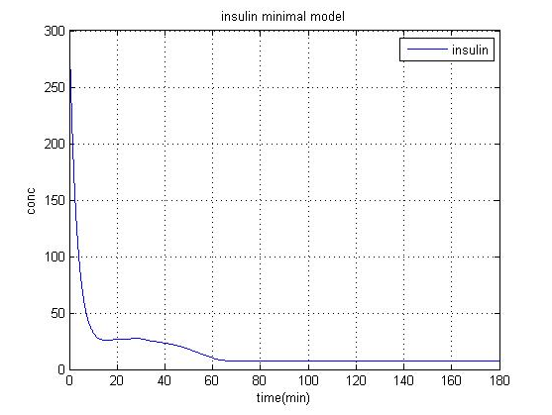
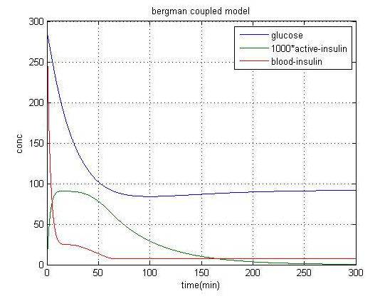
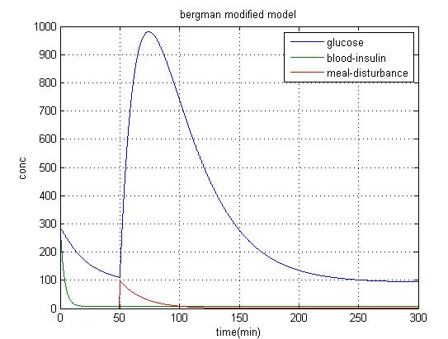
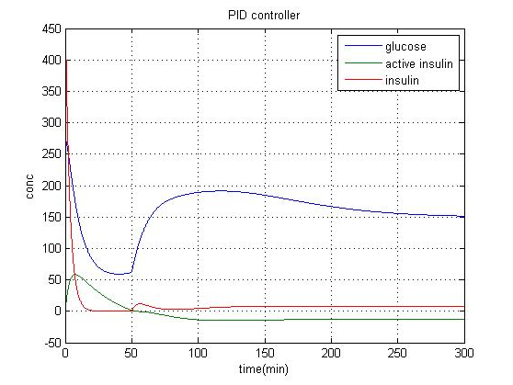
RESULT

Slide 16
As shown in the results, the model works fine with the IVGTT test data (result1 & result2) which consolidates the fact that the model is accurate enough and the evaluation works fine. Also the modified minimal tends to converge even in case of open loop or when no insulin is provided but it takes more time and glucose concentration might rise to a very high value in between. In case of PID controller, the glucose converges to Gset, the only drawback is that the X(t)[active insulin] becomes negative when using the controller, which should not happen. It raises doubts about the model itself which should be dealt with, without moving further.
As per the future work is concerned I am currently working on Linear Quadratic Control Algorithm(LQR) which is related to Algebraic Riccati Equation, I will then start working on the non-linear controller like SDRE tracker.

Slide 17
THANKS

